Slide 1
Term Project
Machine Learning for Signal Processing (EE603A)
Prof. Vipul Arora
By Group - 14
Aashish Patel (190014)
Prateek Jain (190634)

Slide 2
Introduction
Problem Statements
Task 1: Sound Event Detection (SED) to detect the label, onset, and offset of sound events:- speech and music in audio clip.
Task 2: Audio Tagging to predict the presence of speech and music events in audio clip.
Following steps are involved to accomplish both the tasks
Data Preparation
Modelling
Recurrent Neural Networks (RNNs)
Convolutional Neural Networks (CNNs)
CRNN - Hybrid CNN-RNN
Hidden Markov Model (HMM)
Post Processing

Slide 3
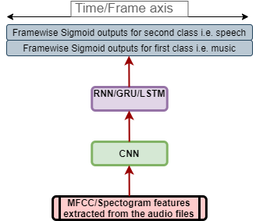
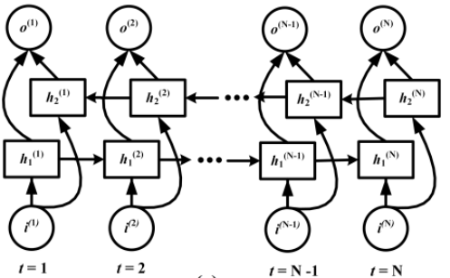
Modelling – CRNN(SED)
We modelled the problem to make framewise predictions on the entire audio clip.
Input of dimension (feature_size, no of frames) is fed to the CNN. The convolutions are such that they keep the size of time/frame axis the same.
Next, we used BiRNN to handle long time dependencies in the spectrograms and find patterns in that. The number of cells in series in this BiRNN = number of frames.
Finally, we used Time Distributed Dense Layers(with Sigmoid) to bring our output to the required dimension.
Final output is of dimension (number of frames, 2) for each spectrogram/audio clip.
Then we post-process these outputs of shape (number of frames, 2) for each class.
RNN layer with output from every cell

Slide 4
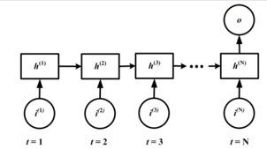
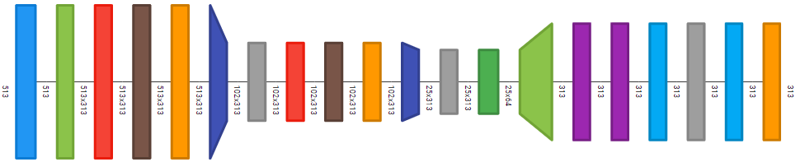
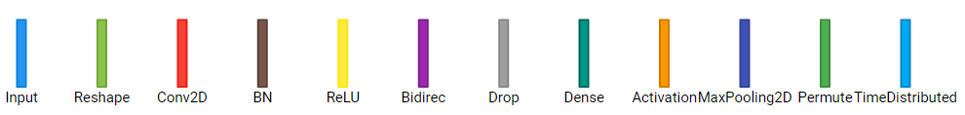
Modelling- NN(Tagging)
We modelled this task with the CNN part same as SED model.
Output of the last Cell of RNN is taken instead of output of all the cells, as done in previous task.
Dense Layers in place of Time Distributed Dense Layers.
Output Dimension is (2) after Sigmoid on top.
We predict the presence of a class in audio if this value > threshold(0.5) for each class.
RNN layer with output being taken only from last cell
CRNN Layers Model

Slide 5
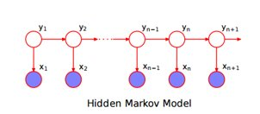
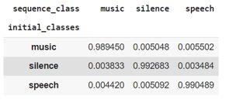
Modelling - HMM
Observed States
Continuous
The spectrogram features vector of size (feature_size, 1) corresponding to each frame
Hidden States
Discrete
Classes {speech, music, silence}
Calculate Initial State Probability Matrix
Calculate Transition State Probability
Calculate the mean and their covariance of GMM by running a for loop on every class and their respective spectrograms
Mean Vector: Shape [number of classes, feature_size]
State Covariance Matrix: Shape [number of classes, feature_size, feature_size]
Prediction
Decode the best sequence of classes given the test observations in the form of windowed spectrograms with the help of calculated initial state probability matrix, state transition matrix, means and covariances of GMM using Viterbi Algorithm under the HMM properties of:
Output Independence
Markov Assumption
Then post-process these outputs of size no of frames to get the onset and offset time for the events
Music | Speech | Silence
0.236111 | 0.380952 | 0.382937
Initial State Probability Matrix
State Transition Probability Matrix

Slide 6
Post Processing of the Outputs of CRNN
Post Processing Steps for each (no of frames) size vectors for each class
Binarization: Convert prob_value > threshold(0.5 for us) to 1, rest entries to 0.
Grouping: Group all the ones together and make a list of contiguous regions.
Merge Small Intervals: Merge intervals with offset of event1 – onset of event 2 < threshold(0.5 for us).
Remove Very Small Events: offset - onset < threshold(0.5 for us).

Slide 7
Data Preparation
Data Preparation
We obtain music and speech data from online sources.
Each audio file is of 30 seconds.
Break these 30s audio files into finite segments of audio having duration 1s to 5s
Recorded silent audio files of duration 1s to 9s
Merged files randomly out of the above prepared sets and resulting audio files will be of 10s each
Prepared a dataset of 1020 audio files with their label.

Slide 8
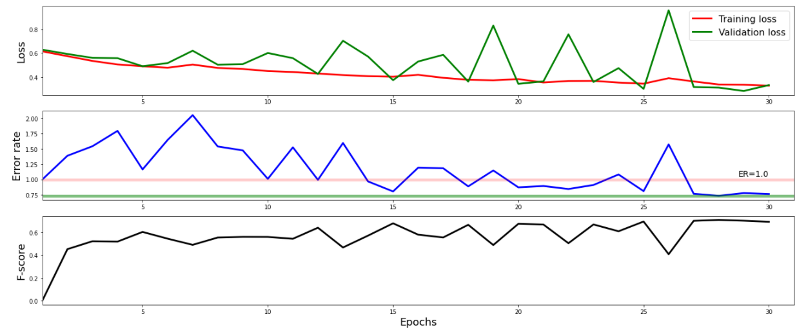
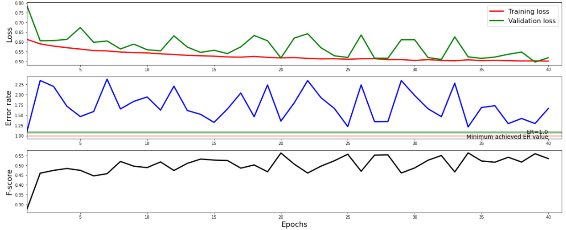
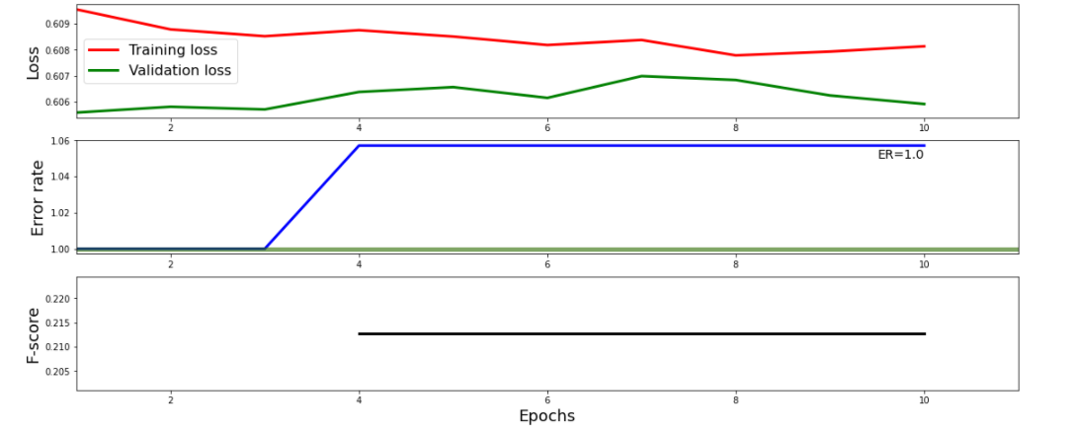
Results
CRNN
Model | F1 Score | Binary Accuracy | Error Rate
CRNN | 0.7515 | 0.821 | 0.41
CNN | 0.58 | 0.710 | 1.34
RNN | 0.2128 | 0.7063 | 1.0571
HMM | 0.9074 | 0.9355 | 0.18
CNN
DCASE based Segment-Based Metrics for SED
Model | F1 Score | Accuracy
CRNN | 0.537 | 0.34
CNN | 0.484 | 0.29
RNN | 0.40 | 0.25
HMM | 0.641 | 0.44
RNN
Audio Tagging Event
RNN

